Slide 1

Vel Tech Rangarajan Dr. Sagunthala R&D Institute of Science and Technology
School of Computing
Department of CSE-Cyber Security
10211CC224 / FULL STACK APPLICATION DEVELOPMENT (JAVA)
PROJECT REVIEW : MILESTONE PROJECT – 1
Date: 02-04-2026
Smart Study Planner
SDG: SDG No – SDG Title(Example: SDG 4 – Quality Education)
Presented By:
STUDENT NAME: Kopparthi Sai Pavan – VTU25916 – Reg.No.23UESS0036
Courses Handling Faculty:
Dr. Shahul Hameed C- Assistant Professor

Slide 2
INTRODUCTION
Background:
Modern education has shifted heavily toward digital resources, leaving students overwhelmed with numerous PDFs, PPTs, and web links across various subjects
Problem Context:
Manually managing these files and tracking study tasks across different platforms often leads to academic disorganization and missed deadlines
Importance:
This project is crucial for creating a structured learning environment that integrates resource management with active study tools.
Real-world Relevance:
As digital learning becomes the standard, students need specialized tools—rather than general storage—to streamline their exam preparation and daily productivity
System Overview:
The smart student study planner is a full-stack Java application that centralizes document storage, subject organization, and interactive revision boards in one secure platform
1
2
3
4
5
6
7
8
9

Slide 3
PROBLEM STATEMENT
Students currently rely on generic cloud storage or manual folder systems to manage diverse academic resources like PDFs and PPT
This manual approach leads to significant inefficiency in retrieving specific documents during exam preparation.
The existing tools lack a centralized way to link study materials directly to a specific subject-wise schedule.
There is no integrated platform that combines document storage with active study aids like revision cards and task reminders.
As a result , students often miss deadlines or struggle with disorganized study environments.
There is a clear need for a simple, automated, and secure system that streamlines study resources and improves academic focus.
1
2
3
4
5
6
7
8
9

Slide 4
OBJECTIVE(S)
1
To design and develop a full-stack Spring Boot application that centralizes student study resources through a subject-linked document management system.
To implement an interactive Study Board with visual revision cards and automated task reminders to improve academic productivity and exam preparation
2
3
4
5
6
7
8
9

Slide 5
PROPOSED SYSTEM
Comprehensive Study Hub:
A centralized platform built with Spring Boot and MySQL that integrates subject management, document storage, and task tracking.
Intelligent File Categorization: Automated system that links uploaded PDFs and PPTs directly to specific subjects for effortless retrieval
Interactive Study Boards: A dedicated module for exam revision featuring visual "Revision Cards" that support both text and images
Smart UI Components: Implementation of Modal Overlays allows users to view and edit revision content without navigating away from the main dashboard
Direct Browser Viewing: Eliminates local storage clutter by allowing users to view study materials directly within the browser tab
Integrate productivity and growth:Includes a to-do-list with automated reminders to help students manage deadlines and academic schedules.
Live Activity Tracking: A real-time dashboard feed that logs recent user actions, ensuring a seamless "pick-up-where-you-left-off" experience
Robust Security: Features secure Spring Security authentication and a dedicated profile management system for personal data protection
1
2
3
4
5
6
7
8
9

Slide 6
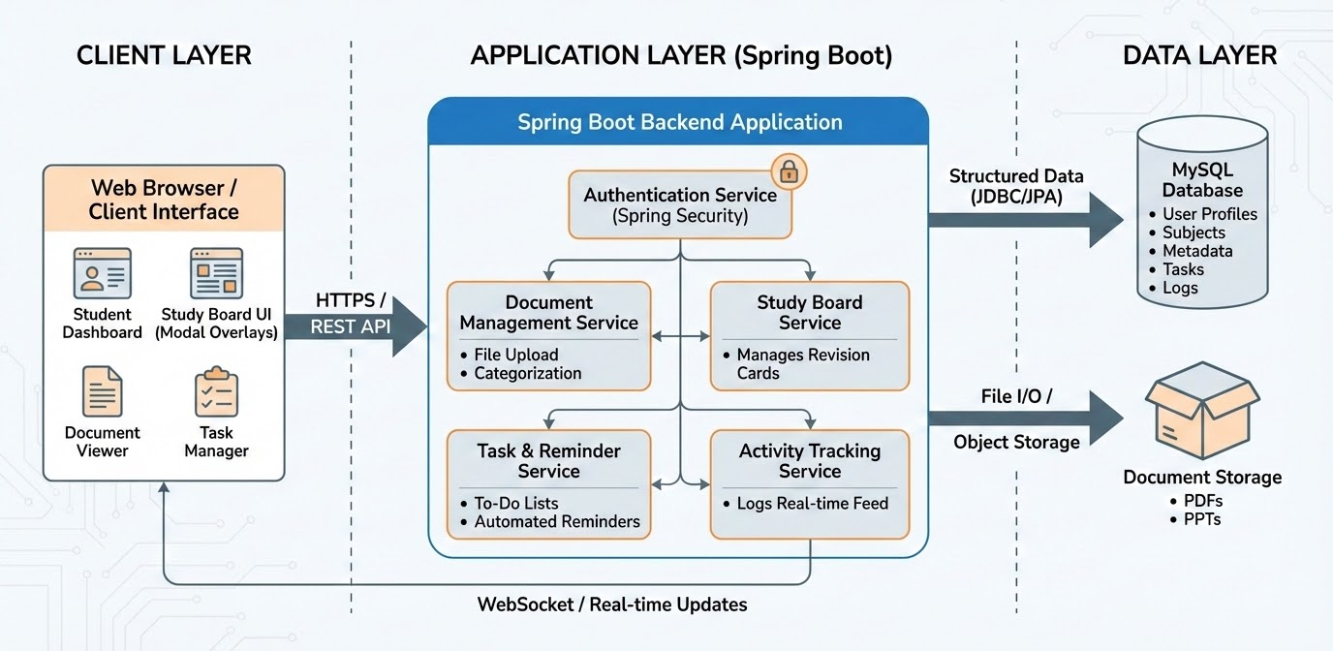
PROPOSED SYSTEM ARCHITECTURE
1
2
3
4
5
6
7
8
9

Slide 7
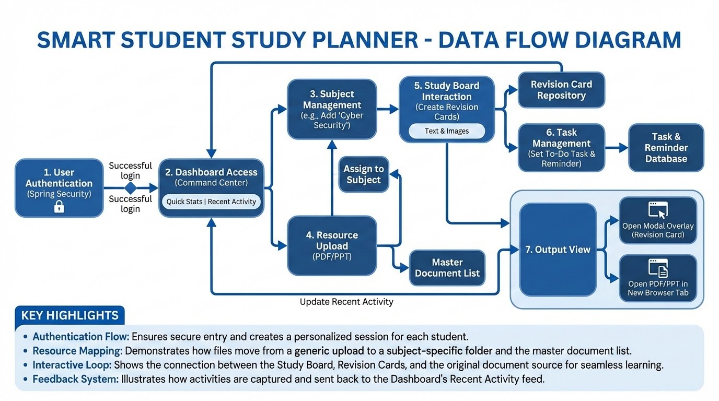
WORKFLOW
1
2
3
4
5
6
7
8
9

Slide 8
TECHNOLOGIES USED
Frontend:
HTML, CSS, Postman (for API testing)
Backend:
Spring Boot, Java (JDK 17+), Spring Web (REST API).
Database:
MySQL
Tools:Postman, IntelliJ IDEA / Eclipse, Maven (build tool).
Hardware:
Minimum 4GB RAM,
Laptop/Desktop System.
Software Requirements:
Java JDK 17+,
Spring Boot,
MySQL,
IntelliJ / Eclipse IDE,
Postman
1
2
3
4
5
6
7
8
9

Slide 9
MODULE DESCRIPTION
Module 1: User Authentication & Security
Manages secure user registration and login using Spring security
Provides profile management, including data updates and password encryption
Module 2: Content & Resource Management
Handles the core logic for adding, editing, and deleting Subjects
Facilitates the Smart Upload of PDFs and PPTs, linking files directly to their respective subject categories
Module 3: Interactive Revision Board :
Implements the Revision Card system, allowing users to create study aids with text and images.
Includes the Modal Overlay feature for quick content viewing and live editing without page reloads.
Module 4: Productivity & Activity Tracker
Manages the To-Do List and automated reminders for academic tasks.
Generates the Recent Activity Feed on the Dashboard to provide a chronological log of user progress
1
2
3
4
5
6
7
8
9

Slide 10
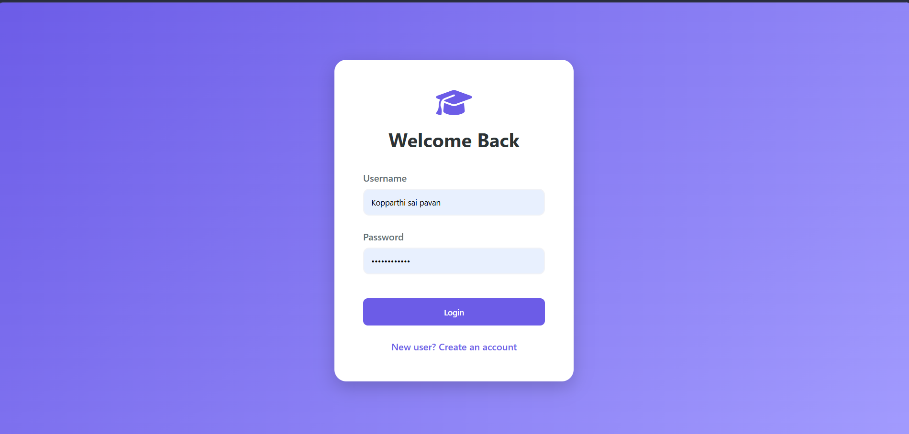
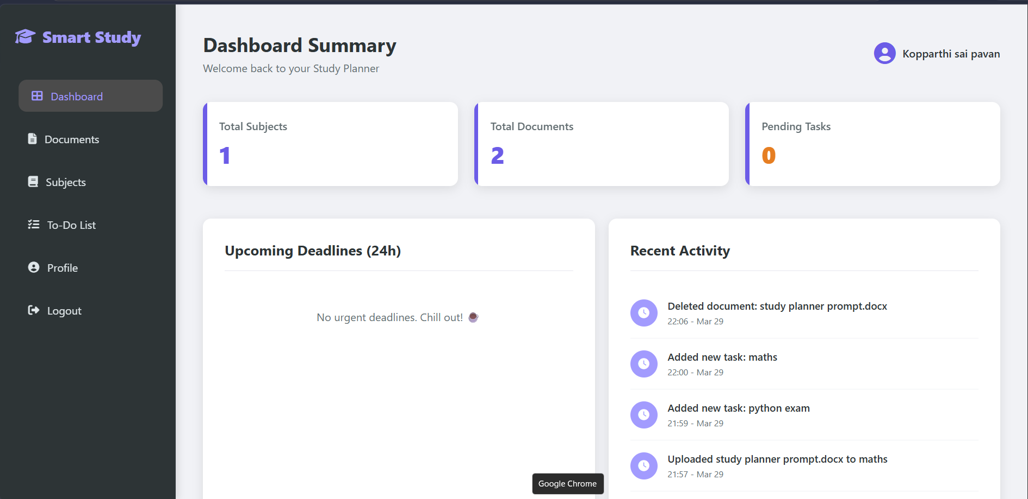
IMPLEMENTATION SCREENSHOTS
1
2
3
4
5
6
7
8
9

Slide 11
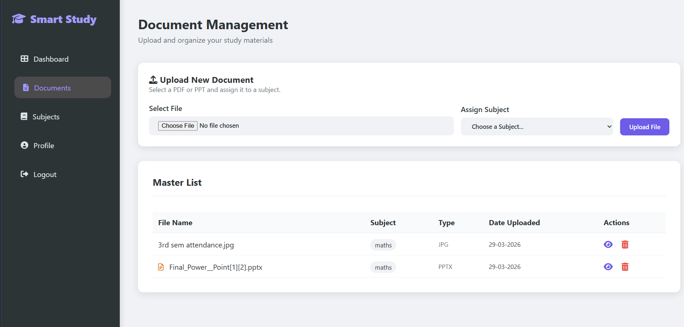
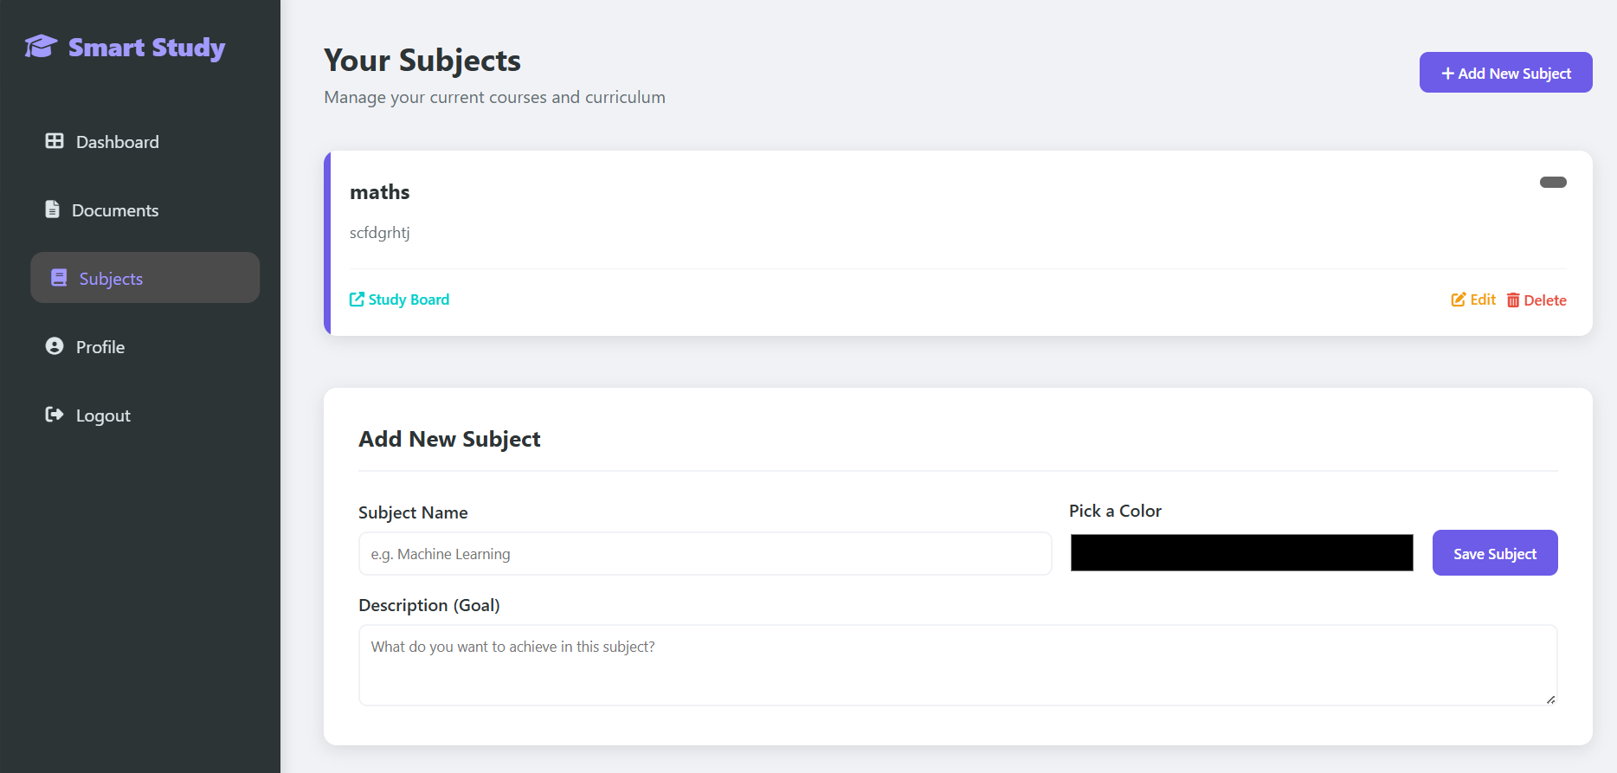
IMPLEMENTATION SCREENSHOTS
1
2
3
4
5
6
7
8(A)
9

Slide 12
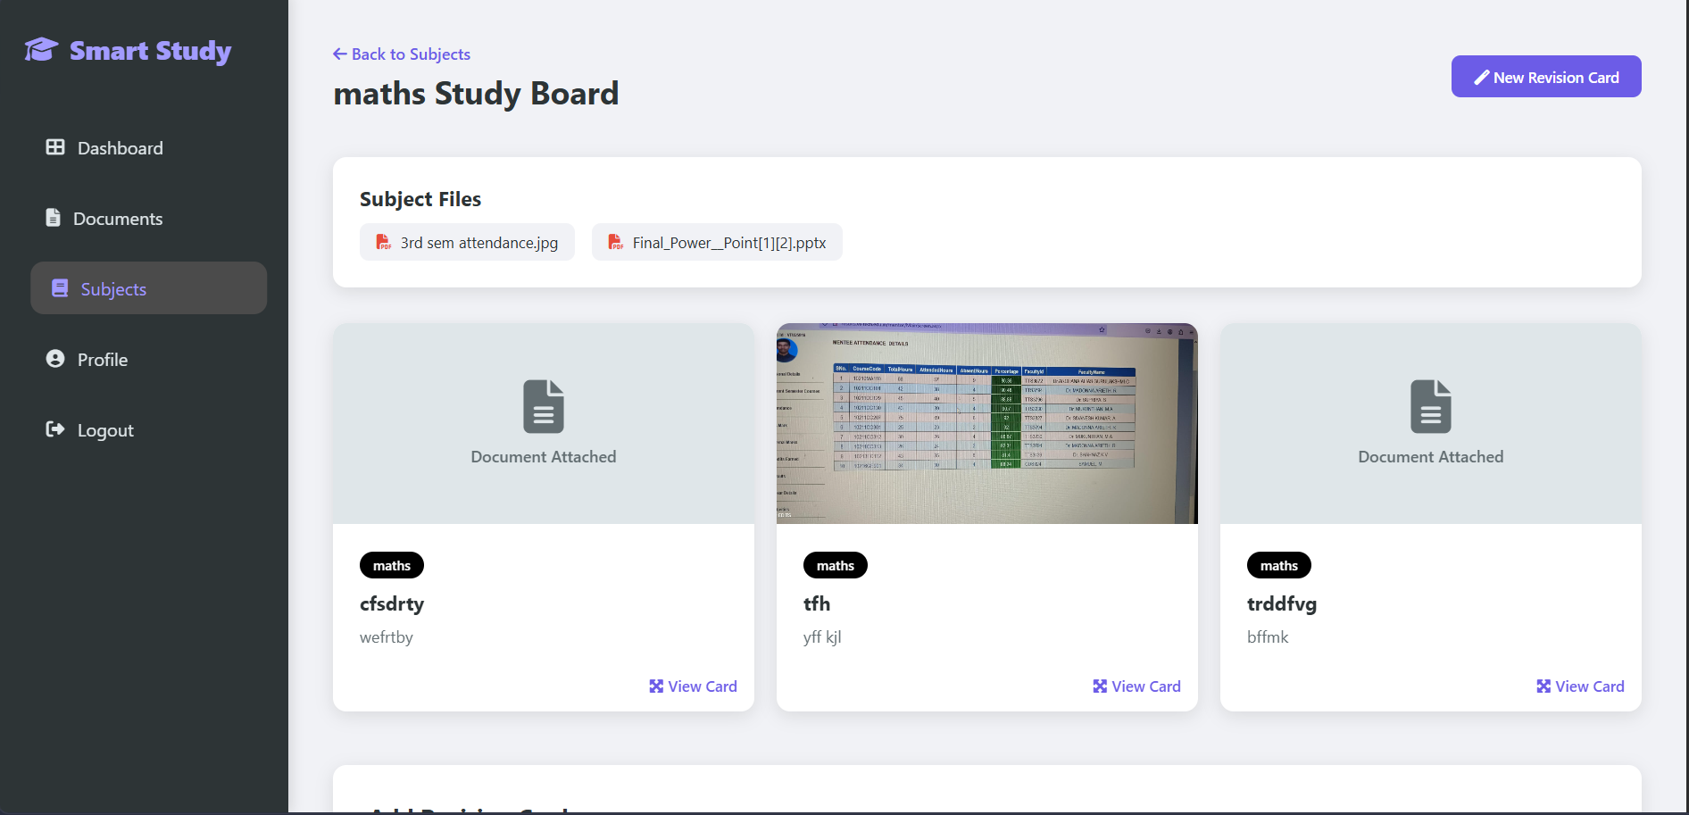
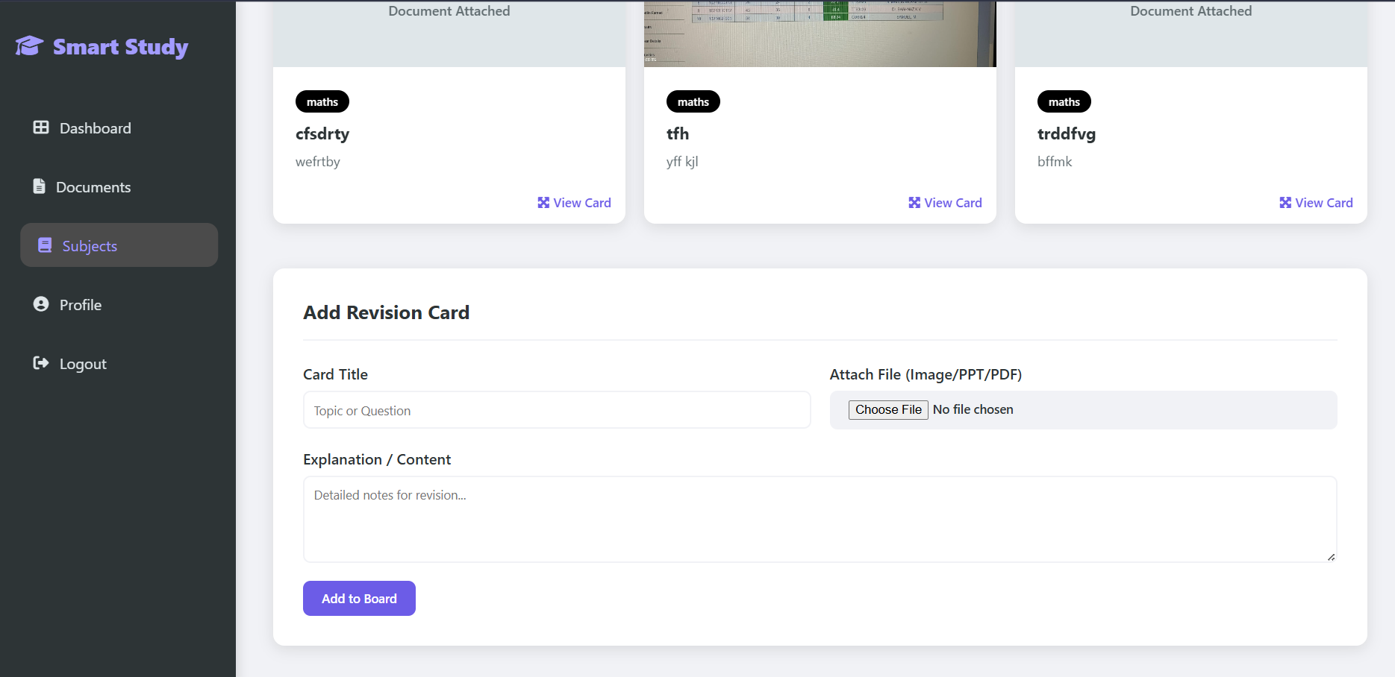
IMPLEMENTATION SCREENSHOTS
1
2
3
4
5
6
7
8(B)
9

Slide 13
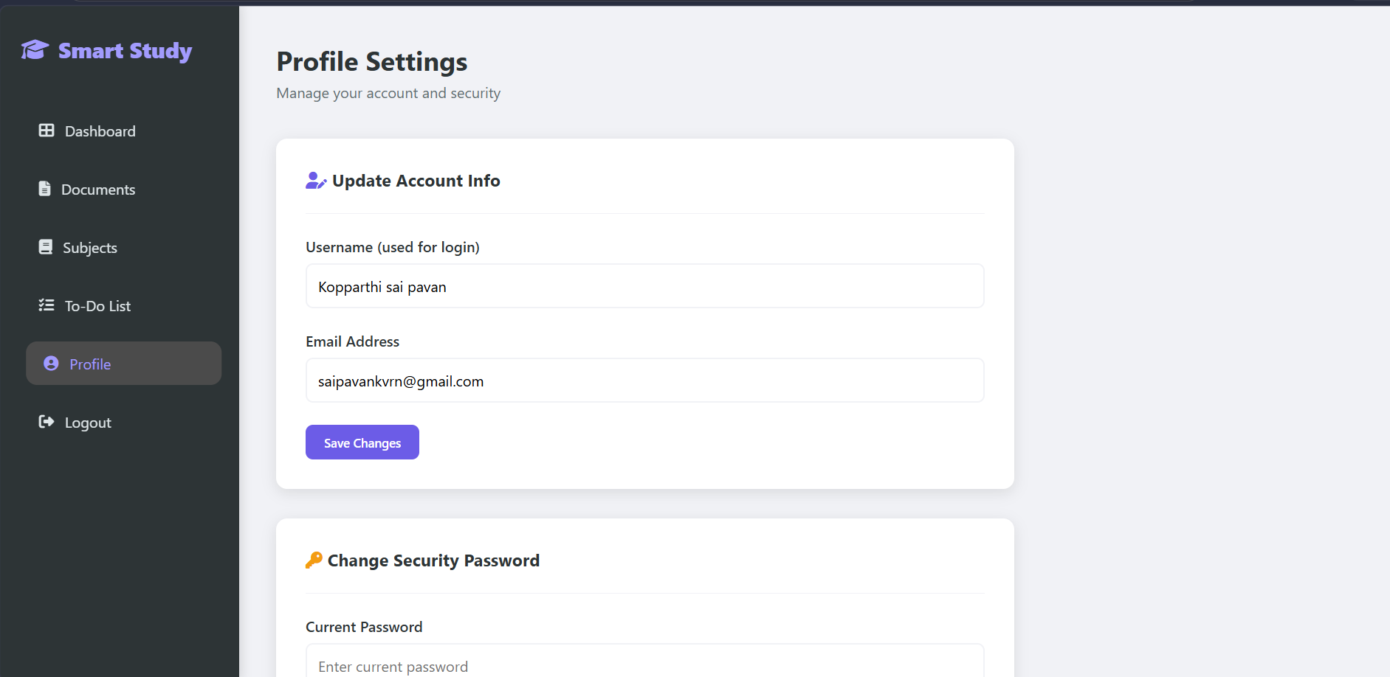
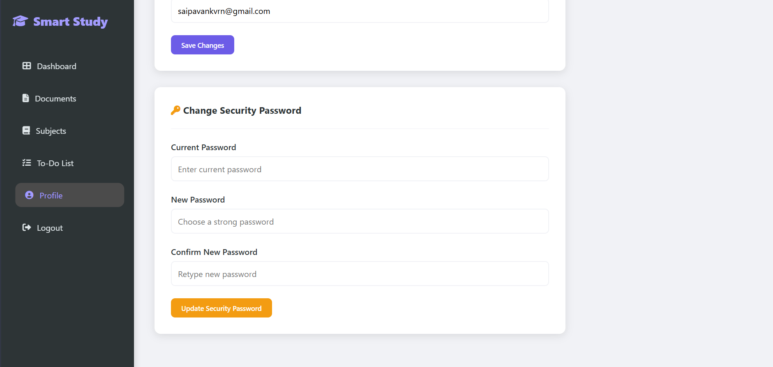
IMPLEMENTATION SCREENSHOTS
1
2
3
4
5
6
7
8(C)
9

Slide 14
ADVANTAGES & LIMITATIONS
ADVANTAGES: Centralized Learning Hub: Integrates document storage, subject tracking, and task management into a single platform, reducing academic disorganization. Smart Study Tools: Features like Revision Card Modals and subject-linked document mapping provide a more focused study experience than generic file explorers. Enhanced Productivity: Real-time tracking through the Recent Activity Feed and automated To-Do Reminders keep students on schedule. Professional Tech Stack: Built using industry-standard technologies like Spring Boot, MySQL, and Spring Security, ensuring scalability and data safety.
LIMITATIONS: Offline Access: The application currently requires a server connection; offline mode with local storage synchronization is not yet implemented. Limited File Formats: While optimized for PDFs and PPTs, the system does not currently support real-time editing of these documents within the browser. Manual Entry: Revision cards and tasks must be entered manually; automated summary generation via AI (like Gemini) is a planned future update.
1
2
3
4
5
6
7
8
9

Slide 15
Thank you

